Slide 1

Review of studies to motivate implementation and design of serious game
By Loftie Fourie

Slide 2
overview
Colour
Texture
Music
Motivational reassurance
Design

Slide 3
Colour
Colour here, there, and in-between – Placemaking and wayfinding in mental health environments (2021)
Research article done by:
Fiona McLachlan
Xuechang Leng

Slide 4
Colour STUDY
Examples of practice-led applied research within occupied healthcare facilities
Considers the role of colour as part of the everyday experience for all users, patients as well as staff and visitors

Slide 5
Colour findings
Findings:
Research suggests that the use of memorable graphic images, combined with vivid colour, can aid navigation
In an example it showed that a strong red and patterned panel acted as a beacon and was sufficiently memorable to direct patients
Since these colour changes incidents of aggression between patients and staff significantly reduced
This shows the effects colours can have on patients not only in wayfinding but QoL as well.

Slide 6
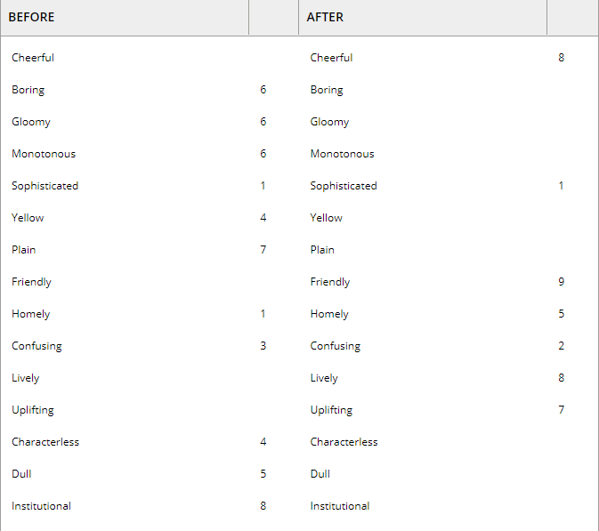
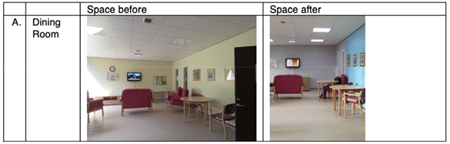
Result of questionare

Slide 7
Texture
From finger friction to brain activation: Tactile perception of the roughness of gratings (2019)
Study done by:
Wei Tang
Rui Liu
Yibing Shi
Chunai Hu
Shengjie Bai
Hua Zhu

Slide 8

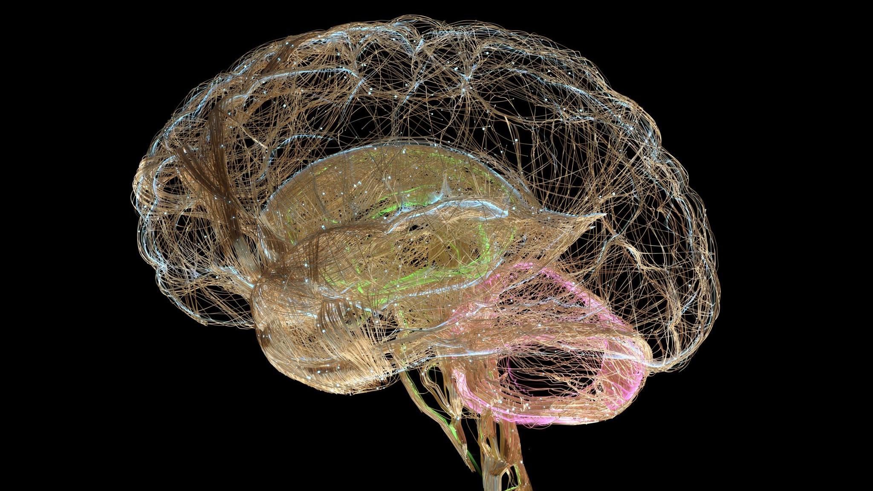
Texture study
The formation of tactile perception is related to skin receptors and the cerebral cortex (Outer layer of brain responsible for thinking learning and consciousness)
Samples with different grating widths and spaces were used

Slide 9
Texture results
This study proofed that there was a relationship between the activation in brain regions, surface friction, and contact conditions of skin during the tactile perception
Through this study it is shown that there is a connection between how our skin responds to textures and how our brain processes touch
Thus using rougher textures with wider grating withs and spaces allows for more stimulation

Slide 10
Music
Progress in Brain Research Chapter 11 – Music and demntia (2015)
Study done by:
Amee Baird
Séverine Samson
Geriatric Clients' Preferences for Specific Popular Songs to Use during Singing Activities (2009)(only references an age group of 65 years or older so might not be relevant anymore)

Slide 11
Music Study
Accumulating evidence shows that persons with dementia's ability to respond to music is potentially preserved even in the late or severe stages of dementia when verbal communication may have ceased.
A large number of studies have claimed that music-based interventions have positive effects on various measures of functioning including behaviour, agitation, mood, emotion, and cognition.

Slide 12
Music results
Music Therapy for Dementia (2021)
Reagan Greenwood
unreliable article I found that mentions specific music that stimulates dementia patients and encourages them to dance, sing and move along.
It mentions the benefits such as Enhanced memory, lowered stress levels, reduced symptoms of depression and more.
It also mentions that using sing along classic music provided the best results.

Slide 13
Motivational reassurance
(1) Physical activity engagement strategies in people with mild cognitive impairment or dementia – a focus group study (2020)
(2) Behaviour patterns detection for persuasive design in nursing homes to help patients (2011)

Slide 14
Motivational reassurance studies
Self-motivation:
Some Participant found goal setting to be a great motivator while some felt they would set themselves up to fail (1).
Keeping these goals in mind were difficult for some with memory problems and they needed reminders for their goals (1).
External motivation:
Most patients and relatives welcomed music into their exercise with only one forgetting how to switch her audio player on (1).
The use of persuasive motivation techniques allows us to motivate people to change behavior disorders and promote healthy behavior patterns (2)
Changing the attitudes of patients through persuasion and social influence instead of coercion

Slide 15
Motivational reassurance results
(1)
Clinicians should use goal setting with caution as it is only preferred by some who enjoy the activities
Thus, keeping score without them knowing and motivating them using that as reference
(2)
Using persuasive motivation allows the patients to be more accepting of changes

Slide 16
Design
Effects of viewing a preferred nature image and learning preferred music on engagement, agitation, and mental status in persons with dementia (2015)
Study done by:
Julia Eggert et al.
Effects of working memory deficits on the communicative functioning of Alzheimer’s dementia patients (2003) (working to find other studies that are more recent)

Slide 17
Design study
Testing proactive strategies for enhancing engagement and cognitive ability
Measuring the effects of exposure to music and nature images on engagement

Slide 18
Study Results
The study revealed that the use of both music and nature images hold promise for reducing undesirable behaviours and improving engagement in residents
These findings thus imply that by using the right images as well as music can potentially enhance the quality of life for not only the care recipient but the care giver as well

Slide 19
Conclusion
These studies and more will serve as not only a template but also as a design philosophy of the serious game, as I will use these studies to decide the aesthetics, methods as well as overall design and purpose of the game.
My aim for this game is to use every aspect of the game to improve cognitive function, mood, behaviour and through this quality of life of patients with dementia.

